Slide 1
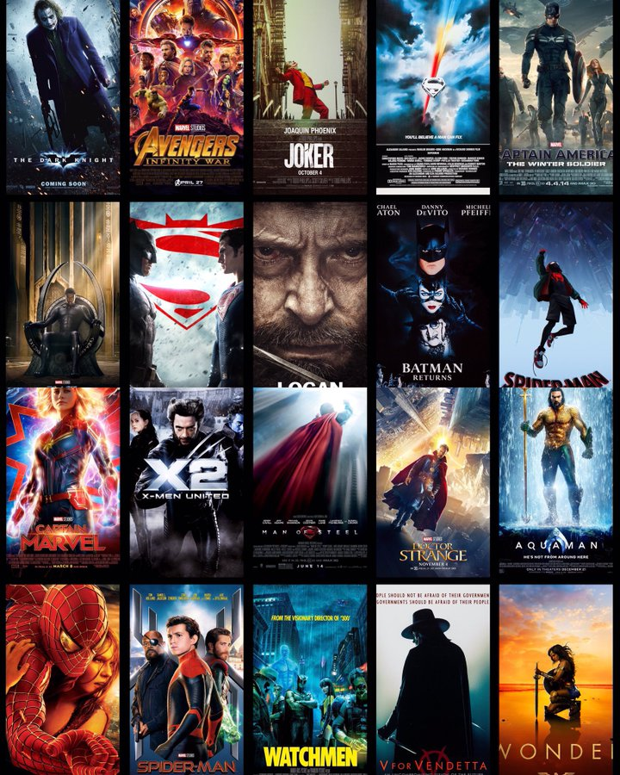
BookFastShow
By -
AJINKYA Vijay CHINCHKAR.

Slide 2
-: SCENARIO:-
I have built ONLINE MOVIE TICKET BOOKING SYSTEM.
In this project, I have created User Interface and Admin
Interface which has functionality of Register, Login and then followed by functionality of adding movies and booking tickets which consists of CRUD (Create,Update,Delete) operations.

Slide 3
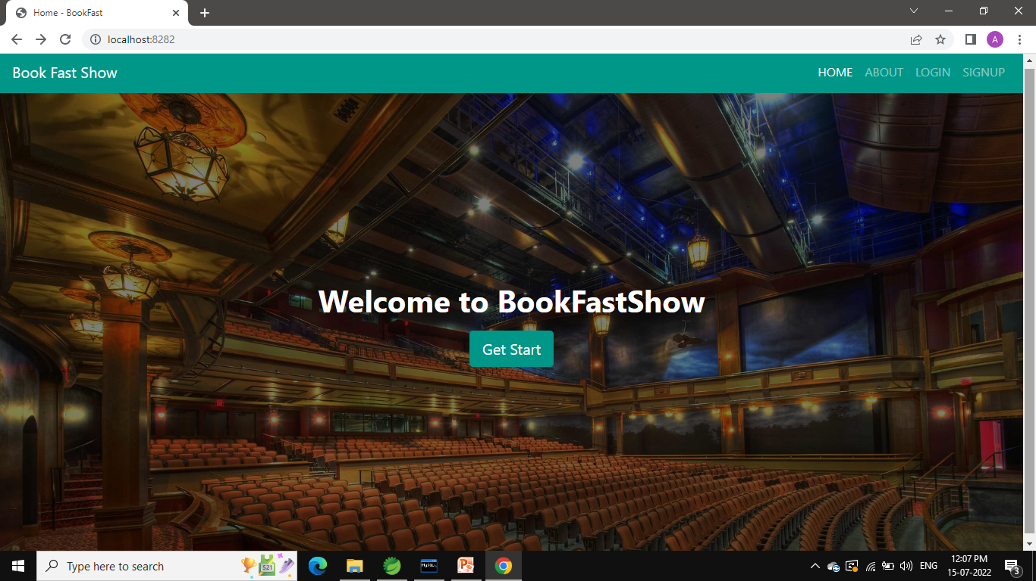
HOME PAGE

Slide 4
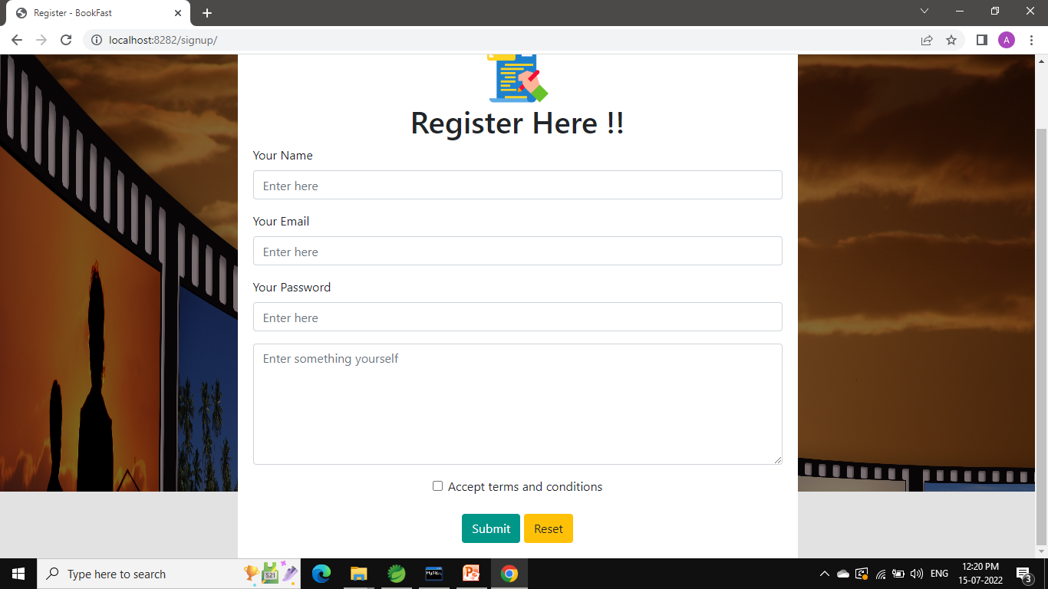
SIGN UP PAGE

Slide 5
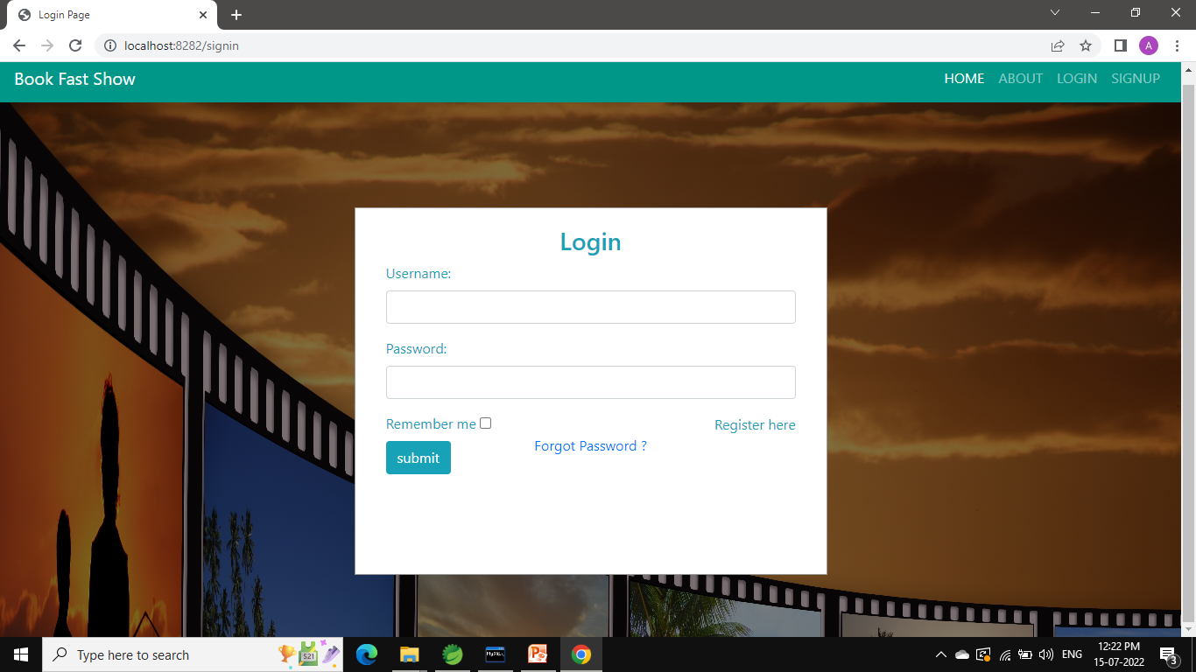
LOGIN PAGE

Slide 6
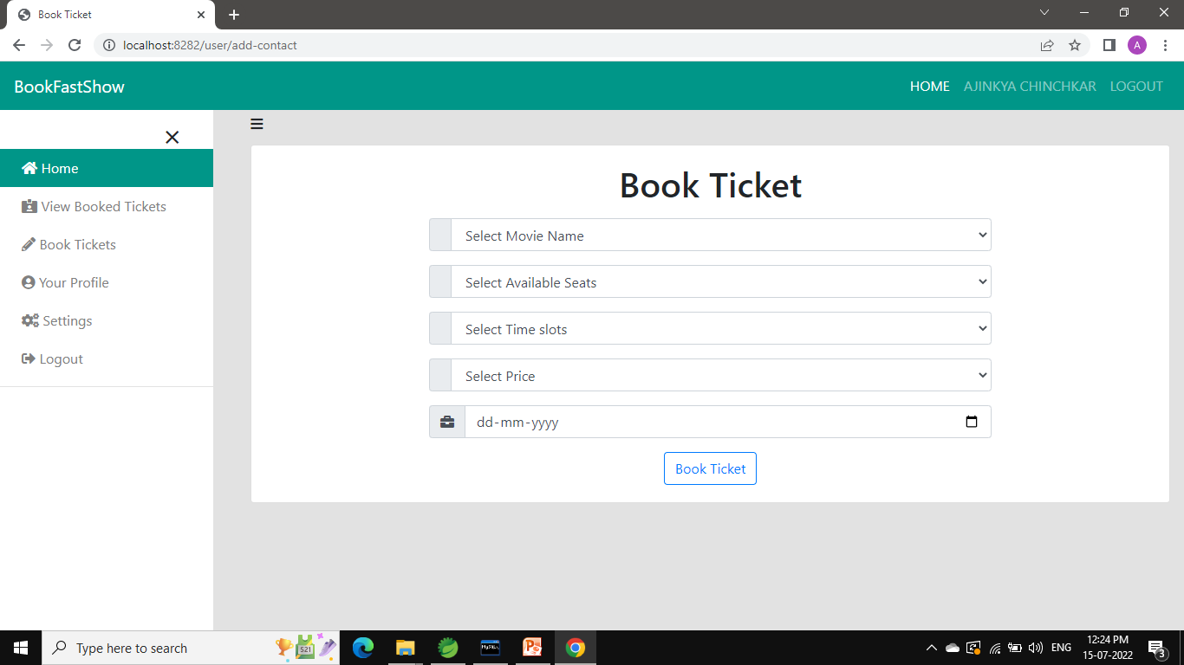
BOOKING PAGE

Slide 7
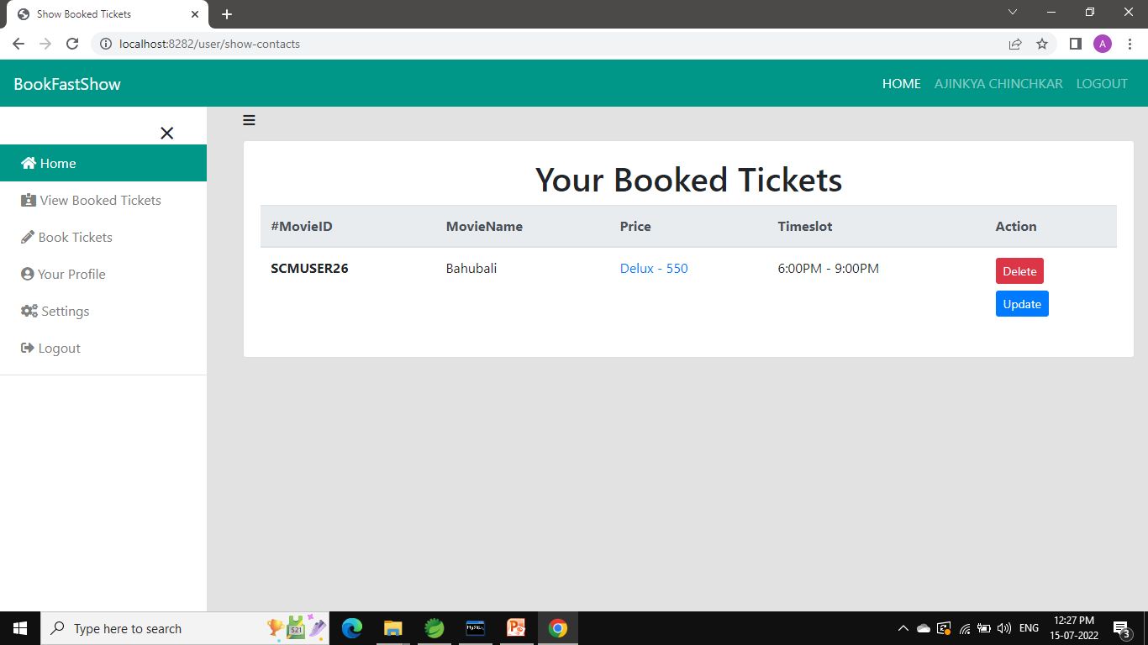
SUMMARY OF BOOKING

Slide 8
THE IDEA
In first page, I have showed basic UI which comprises of Home, About Login, Signup options.
Firstly the User needs to Signup and then only he can Login, Here I have used validation for login i.e only the registered email-id will be validated for logging in.
After the user logins, he/she will be able to book tickets for select movies, seats, time slots, and date which user wish for.
When booking is done, user can see his/her summary of booking and will also have options to update or delete the movies already booked.

Slide 9
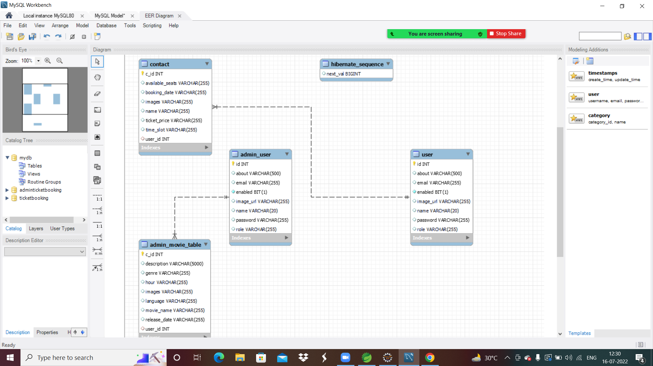

Slide 10
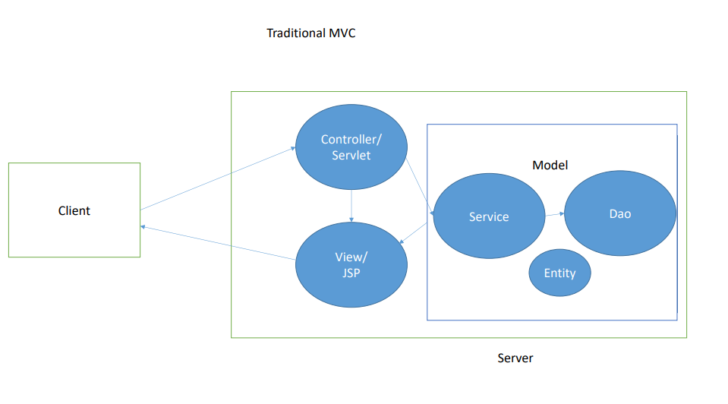
THE CONCEPT
Database

Slide 11
THANK YOU !

